Slide 1
Data Exploratory Findings
A peek of the key factor to your business success
By Lu Yonghao, 2022, feb, 20

Slide 2
Topics Today
Data findings
&
Things we could done
Is money a factor?
Futher possibilities

Slide 3
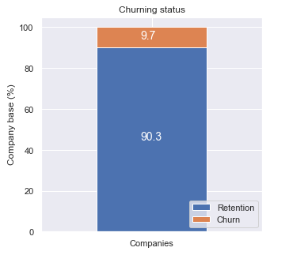
Data findings
*How many customer have churned?
*What kind of customers churned?
*What kind of customer is likely to stay?

Slide 4
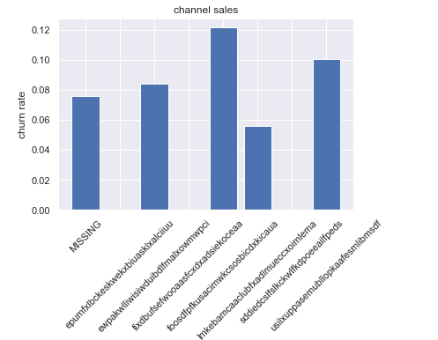
Data Findings - Channel
Data Exploratory
- Highest and lowest churn rate in different channel
Proportion adjustment,
Futher investigation on poorly performce channel

Slide 5
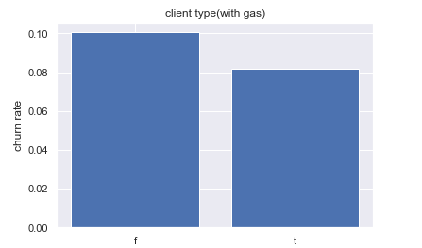
Data Findings - Client Type
Data Exploratory
- Different churn rate between different Type of Client
Service promotion

Slide 6
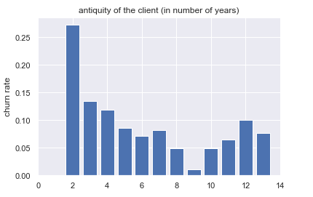
Data Findings - Number of years
Data Exploratory
- Two important year - 3rd and 9th
Maybe Good target for discount and other promotion,
Further investigation

Slide 7
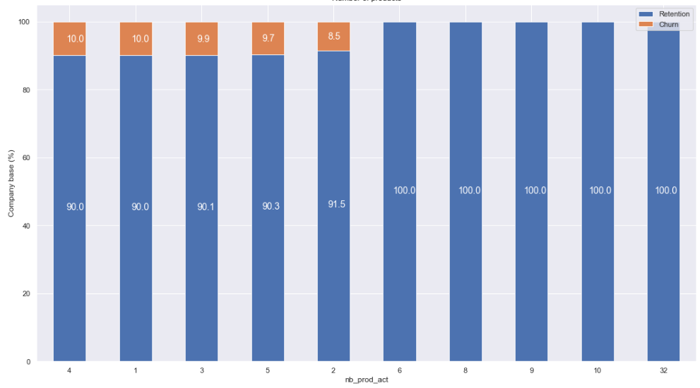
Data Findings - Products
Data Exploratory
- Little customer churn for having more than 5
products/services

Slide 8
Giving Discount
Does it really work?

Slide 9
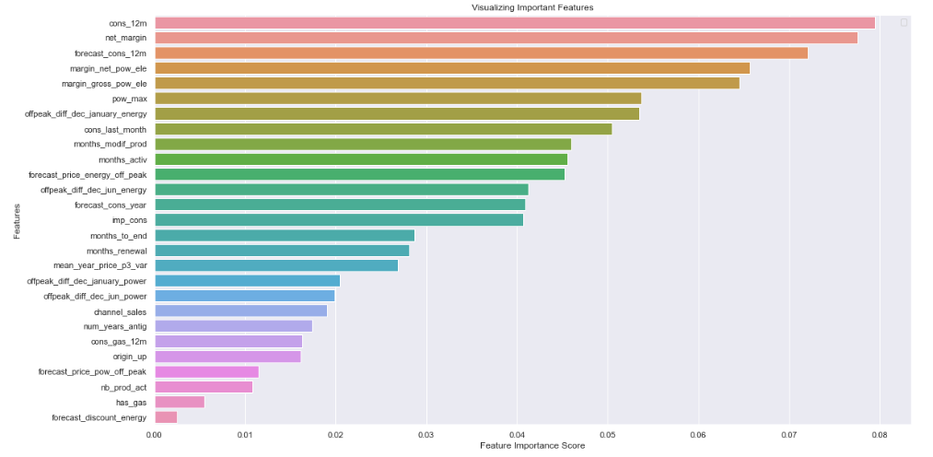
Price is not a key factor,
but is a weak contributor
Top drivers
Influential driver
Price sensitivity features are cattered
around but are not the main driver for
a customer churning

Slide 10
Summary

Slide 11
Thank you
By Lu Yonghao, 2022, feb, 20

